Slide 1

Grants Workshop

Slide 2

Who
America250 Mississippi Commission
Created by the Mississippi Legislature to organize and coordinate statewide events and initiatives for the America250 semiquincentennial, empowering local communities to celebrate Mississippi's unique history, honor its role in the American story and inspire future generations to appreciate the state's diverse past through education and engagement.

Slide 3

Who
Mississippi Humanities Council
A private nonprofit corporation funded by Congress through the National Endowment for the Humanities to create opportunities for Mississippians to learn about themselves and the larger world and to enrich communities through civil conversations about our history and culture.

Slide 4
What
The America250 Mississippi grant program aims to empower local organizations to honor their unique histories, foster a deeper understanding of Mississippi’s vital role in the American story and inspire meaningful engagement with our shared heritage. By supporting public events and initiatives during the semiquincentennial, the program seeks to create lasting legacies that will help future generations of Mississippians appreciate and celebrate the rich and diverse tapestry of our state’s past.

Slide 5
Themes
Applicants are encouraged to develop projects that explore at least one of the following four themes:
  We the People
  The Power of Place
  Mississippi in the American Story
  Mississippi Traditions

Slide 6
Themes
We the People
Inspired by the founders’ ideals, generations of Mississippians have fought for their rights to life, liberty, and the pursuit of happiness. This theme explores how the definition of “We the People” has evolved over time, highlighting Mississippi’s pivotal role in expanding the definition of American citizenship.

Slide 7
Themes
The Power of Place
Mississippi’s landscape and communities have been shaped by centuries of change. This theme invites projects that examine how place has influenced the development of Mississippi’s unique identity and how your community’s story contributes to the state’s shared narrative.

Slide 8
Themes
Mississippi in the American Story
Mississippi has played a vital role in the nation’s history. This theme supports projects that examine how Mississippi has been at the center of major American events and movements—political, economic, social and cultural—underscoring the state’s impact on the broader American story.

Slide 9
Themes
Mississippi Traditions
Mississippi is renowned for its creative spirit and cultural traditions. This theme celebrates the state’s rich heritage in literature, music, visual arts and folklife—from Choctaw and Chickasaw traditions and the birth of the blues and country music to the literary giants who sought to explain a place like Mississippi to the world - and explores how creativity and tradition sustain and inspire Mississippians today.

Slide 10
Grant Types
Legacy Grants
  Purpose: To support larger projects that enhance a community’s capacity to explore and promote local history, leaving a lasting legacy for future generations.
  Eligible Projects: Examples include expansion or enhancement of local history museums, development of multimedia historical tours, publication of community histories, community-wide oral history or archival projects, online exhibits, or substantial documentary media projects.
  Grant Amount: Up to $20,000
  Cost Share: Must be matched 1:1, with at least 50% of the match being cash, the remainder can be in-kind.
  Deadlines: December 1, 2025; February 1, 2026

Slide 11
Grant Types
Program Grants
  Purpose: To support local celebrations of the semiquincentennial and public programs that explore the themes of America250 Mississippi.
  Eligible Projects Include: Festivals, concerts, lecture series, living history programs, theatrical productions, local history projects, literary events, traveling exhibits, oral history initiatives, discussion programs, etc.
  Grant Amount: Up to $10,000
  Cost Share: Must be matched 1:1, with at least 10% cash, the remainder can be in-kind
  Deadlines: September 15, 2025; November 15, 2025; January 15, 2026; March 15, 2026.

Slide 12
Grant Types
Mini Grants
  Purpose: To provide accessible, flexible funding for small-scale, grassroots projects and local activities commemorating America250.
  Grant Amount: Up to $5,000
  Cost Share: Must be matched 1:1 with either cash or in-kind, or a combination.
  Deadlines: Rolling deadlines until mini grant funds are exhausted.

Slide 13
Eligibility
Who can apply for America250 Mississippi grants?
  Private nonprofit organizations
  Local or statewide historical societies
  Institutions of higher education
  State, local and Indian tribal governments
  Community and cultural organizations
  Educational and professional groups
  Museums
  Libraries
  Public agencies & municipalities
  Non-commercial radio and television stations
  Convention & Visitors Bureaus

Slide 14
Ineligible Uses
America250 Mississippi grants cannot be used for:
  Projects primarily intended to promote an organization or its programs
  Salaries of employees associated with the applying organization or other overhead costs
  Alcoholic beverages
  Projects that advocate or promote a particular political, ideological, religious or partisan point of view

Slide 15
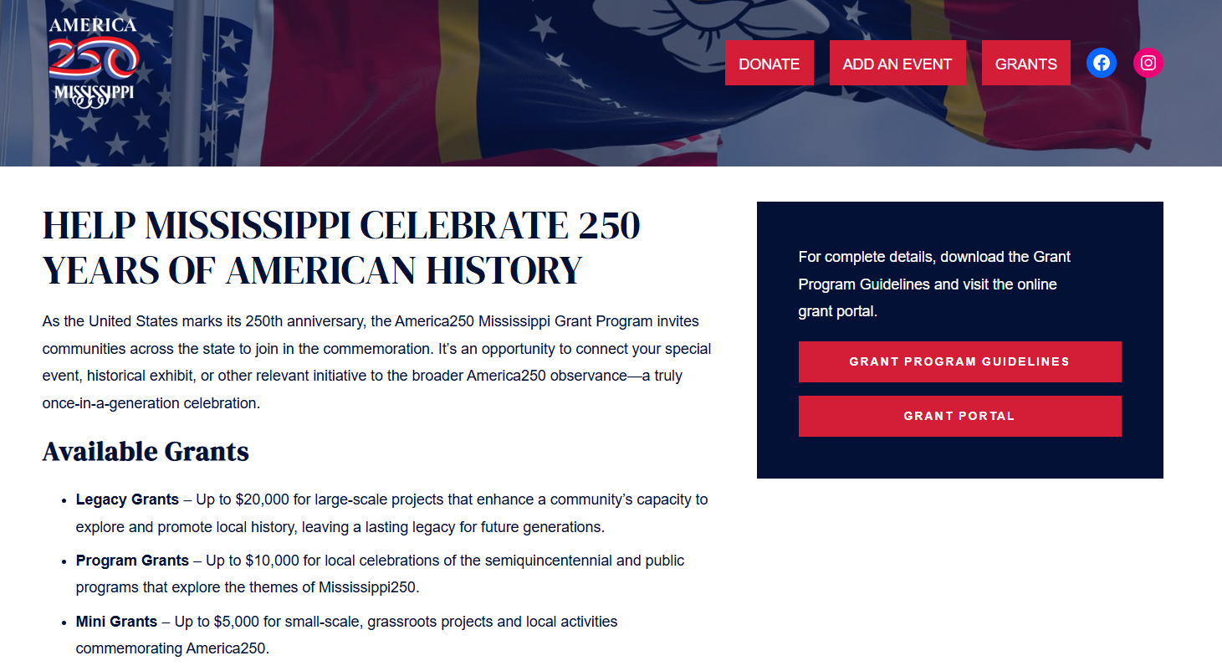
Application Process
Grant Guidelines & Online Application Form
  https://america250.ms/grants/

Slide 16
Application Process
How to Apply
  Step One: Discuss your project with MHC staff.
  Step Two: Submit a rough draft of your grant application.
  Step Three: Submit your online application.
    www.mshumanities.org

Slide 17
Frequently Asked Questions
May I apply for more than one America250 Mississippi grant?
When can my program take place?
How do the deadlines work?
Do I have to apply by September 15 to be sure the funds do not run out?
Can I partner/collaborate with other organizations on the same grant?
Can these grants fund a pre-existing event?
If funded, when will I receive the money?
If I receive an America250 Mississippi grant, am I still eligible to apply for the Mississippi Humanities Council’s grants?
Why are the America250 Mississippi logos so important?
Will these grants fund artistic performances?
What is the grant review process?

Slide 18
Frequently Asked Questions
May I receive more than one America250 Mississippi grant?
When can my program take place?
How do the deadlines work?
Do I have to apply by September 15 to be sure the funds do not run out?
Can I partner/collaborate with other organizations on the same grant?
Can these grants fund a pre-existing event?
If funded, when will I receive the money?
If I receive an America250 Mississippi grant, am I still eligible to apply for Mississippi Humanities Council grants?
Why are the America250 Mississippi logos so important?
Will these grants fund artistic performances?
What is the grant review process?

Slide 19
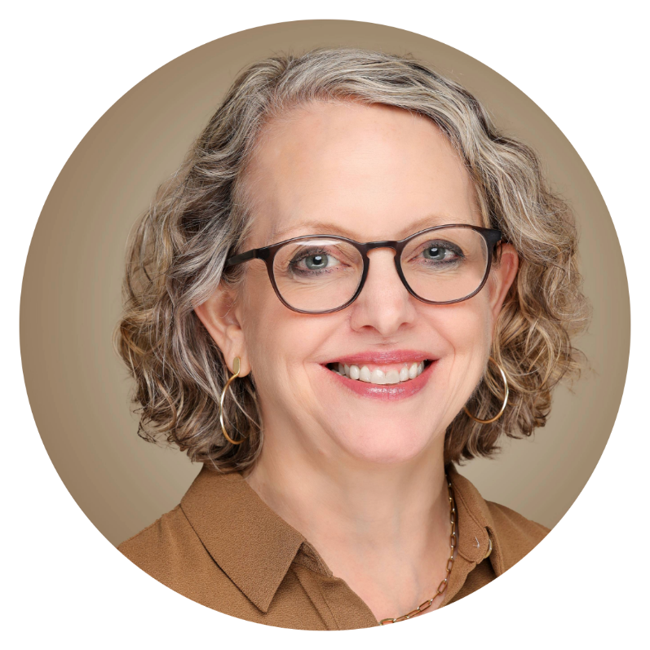
One-on-One Consultations
Carol Andersen
carol@mhc.state.ms.us
601-432-6754

