Slide 1

Grants Workshop

Slide 2

Who
America250 Mississippi Commission
Created by the Mississippi Legislature to organize and coordinate statewide events and initiatives for the America250 semiquincentennial, empowering local communities to celebrate Mississippi's unique history, honor its role in the American story and inspire future generations to appreciate the state's diverse past through education and engagement.

Slide 3

Who
Mississippi Humanities Council
A private nonprofit corporation funded by Congress through the National Endowment for the Humanities to create opportunities for Mississippians to learn about themselves and the larger world and to enrich communities through civil conversations about our history and culture.

Slide 4
What
The America250 Mississippi grant program aims to empower local organizations to honor their unique histories, foster a deeper understanding of Mississippi’s vital role in the American story and inspire meaningful engagement with our shared heritage. By supporting public events and initiatives during the semiquincentennial, the program seeks to create lasting legacies that will help future generations of Mississippians appreciate and celebrate the rich and diverse tapestry of our state’s past.

Slide 5
Themes
Applicants are encouraged to develop projects that explore at least one of the following four themes:
  We the People
  The Power of Place
  Mississippi in the American Story
  Mississippi Traditions

Slide 6
Themes
We the People
Inspired by the founders’ ideals, generations of Mississippians have fought for their rights to life, liberty, and the pursuit of happiness. This theme explores how the definition of “We the People” has evolved over time, highlighting Mississippi’s pivotal role in expanding the definition of American citizenship.

Slide 7
Themes
The Power of Place
Mississippi’s landscape and communities have been shaped by centuries of change. This theme invites projects that examine how place has influenced the development of Mississippi’s unique identity and how your community’s story contributes to the state’s shared narrative.

Slide 8
Themes
Mississippi in the American Story
Mississippi has played a vital role in the nation’s history. This theme supports projects that examine how Mississippi has been at the center of major American events and movements—political, economic, social and cultural—underscoring the state’s impact on the broader American story.

Slide 9
Themes
Mississippi Traditions
Mississippi is renowned for its creative spirit and cultural traditions. This theme celebrates the state’s rich heritage in literature, music, visual arts and folklife—from Choctaw and Chickasaw traditions and the birth of the blues and country music to the literary giants who sought to explain a place like Mississippi to the world - and explores how creativity and tradition sustain and inspire Mississippians today.

Slide 10
Grant Types
Program Grants
Minigrants
Legacy Grants

Slide 11
Grant Types: Program Grants
Program Grants
  Purpose: To support local celebrations of the semiquincentennial and public programs that explore the themes of America250 Mississippi.
  Eligible Projects Include: Festivals, concerts, lecture series, living history programs, theatrical productions, local history projects, literary events, traveling exhibits, oral history initiatives, discussion programs, etc.
  Grant Amount: Up to $10,000
  Cost Share: Must be matched 1:1, with at least 10% cash, the remainder can be in-kind
  Deadlines: September 15, 2025; November 15, 2025; January 15, 2026; March 15, 2026.

Slide 12
Grant Types: Mini Grants
Mini Grants
  Purpose: To provide accessible, flexible funding for small-scale, grassroots projects and local activities commemorating America250.
  Grant Amount: Up to $5,000
  Cost Share: Must be matched 1:1 with either cash or in-kind, or a combination.
  Deadlines: Rolling deadlines until mini grant funds are exhausted.

Slide 13
Grant Types: Legacy Grants
Legacy Grants
  Purpose: To support larger projects that enhance a community’s capacity to explore and promote local history, leaving a lasting legacy for future generations.
  Eligible Projects: Examples include expansion or enhancement of local history museums, development of multimedia historical tours, publication of community histories, community-wide oral history or archival projects, online exhibits, or substantial documentary media projects.
  Grant Amount: Up to $20,000
  Cost Share: Must be matched 1:1, with at least 50% of the match being cash, the remainder can be in-kind.
  Deadlines: December 1, 2025; February 1, 2026

Slide 14
What is NOT a Legacy Grant?
  One-time events or programs
  Events or projects specific to 2026
  Celebrations
  Endowments
  Large-scale public art installments such as murals or sculptures
  Documentary films with a narrow topic or a focus specific to a current topic

Slide 15
Legacy Grant Examples
  Projects that will live on and encourage reflection on Mississippi in 2026
  An investment in a larger project that strengthens how a community preserves and tells its story
  A project that is a lasting investment for your community
  A project related to the themes of the America250 Mississippi grants that will live on (publications, online archives, digitization of a significant historical collection)
  A documentary film that is used as an interpretive orientation to an existing museum exhibit(s)
  Documentary film projects, related to the America250 Mississippi grant themes, that is broadcast statewide or reaches a wide audience
  An oral history that reflects your community’s history and is appropriately archived and made publicly accessible

Slide 16
Keys to a Successful Proposal
  Ambitious projects that use the America250 anniversary to mark, elaborate, interpret and share your local history
  Other significant funding
  Collaborative partnerships
  Demonstrated experience with similar projects
  Clear Alignment with America250
  Consult with MHC Staff

Slide 17
Eligibility
Who can apply for America250 Mississippi grants?
  Private nonprofit organizations
  Local or statewide historical societies
  Institutions of higher education
  State, local and Indian tribal governments
  Community and cultural organizations
  Educational and professional groups
  Museums
  Libraries
  Public agencies & municipalities
  Non-commercial radio and television stations
  Convention & Visitors Bureaus

Slide 18
Ineligible Uses
America250 Mississippi grants cannot be used for:
  Projects primarily intended to promote an organization or its programs
  Salaries of employees associated with the applying organization or other overhead costs
  Alcoholic beverages
  Projects that advocate or promote a particular political, ideological, religious or partisan point of view

Slide 19
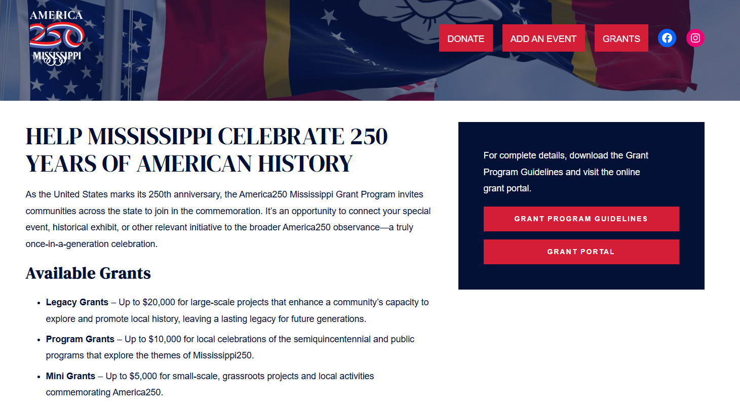
Application Process
Grant Guidelines & Online Application Form
  https://america250.ms/grants/

Slide 20
Application Process
How to Apply
  Step One: Read through the grant guidelines.
  Step Two: Discuss your project with MHC staff.
  Step Three: Submit a rough draft of your grant application.
  Step Four: Submit your online application.
    www.mshumanities.org

Slide 21
Frequently Asked Questions
Can I partner/collaborate with other organizations on the same grant?
When can my program take place?
Can these grants fund a pre-existing event?
Will these grants fund artistic performances?
May I receive more than one America250 Mississippi grant?
May I receive an American250 Mississippi grant from the Mississippi Humanities Council and the Mississippi Arts Commission?
If I receive an America250 Mississippi grant, am I still eligible to apply for Mississippi Humanities Council grants?
How do the deadlines work?
If funded, when will I receive the money?
Do I have to finish the application in one sitting?
What is the grant review process?
Why are the America250 Mississippi logos so important?

Slide 22
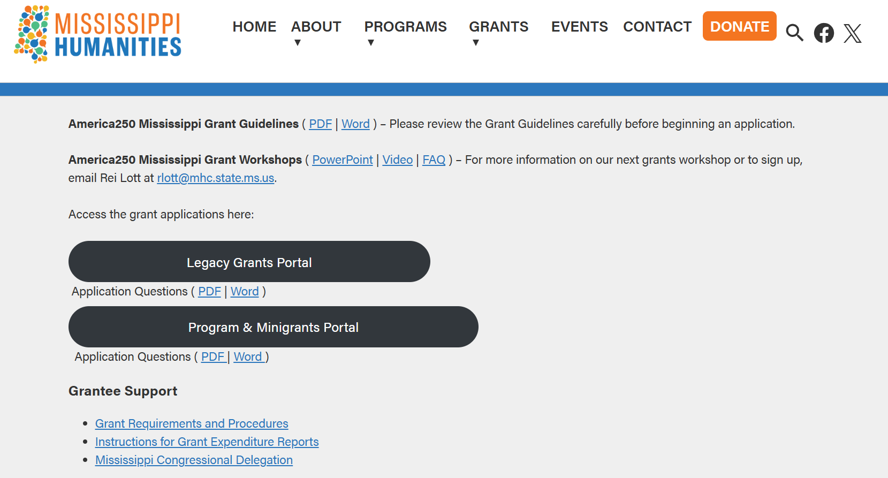
MHC’s Helpful Links
Grant Guidelines, Videos, PowerPoints, FAQ, and More
  mshumanities.org/grants/america250-mississippi-grants/

Slide 23
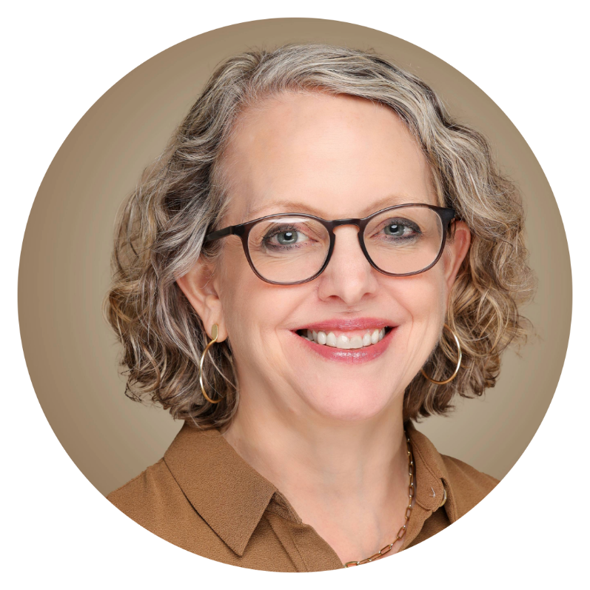
One-on-One Consultations
Carol Andersen
carol@mhc.state.ms.us
601-432-6754

